Slide 1
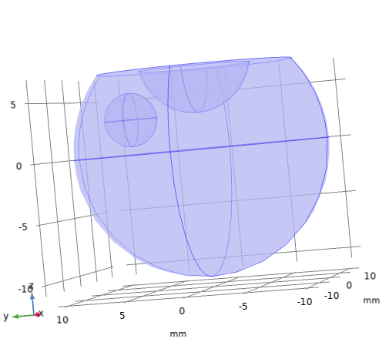
Figure 1
Inflow
u = 0 - 0.00015 mm/s
Drug injected
location
Hyaloid
membrane
C = 0
(all cases)
Anterior
vitreous
outer
surface
C_{i} = 0.167 mol/m³
Lens
No
flux
No flux
Posterior
vitreous
outer
surface
C = 0
(b cases)
Vitreous
Fovea
Outflow
P = 0
a)
b)

Slide 2
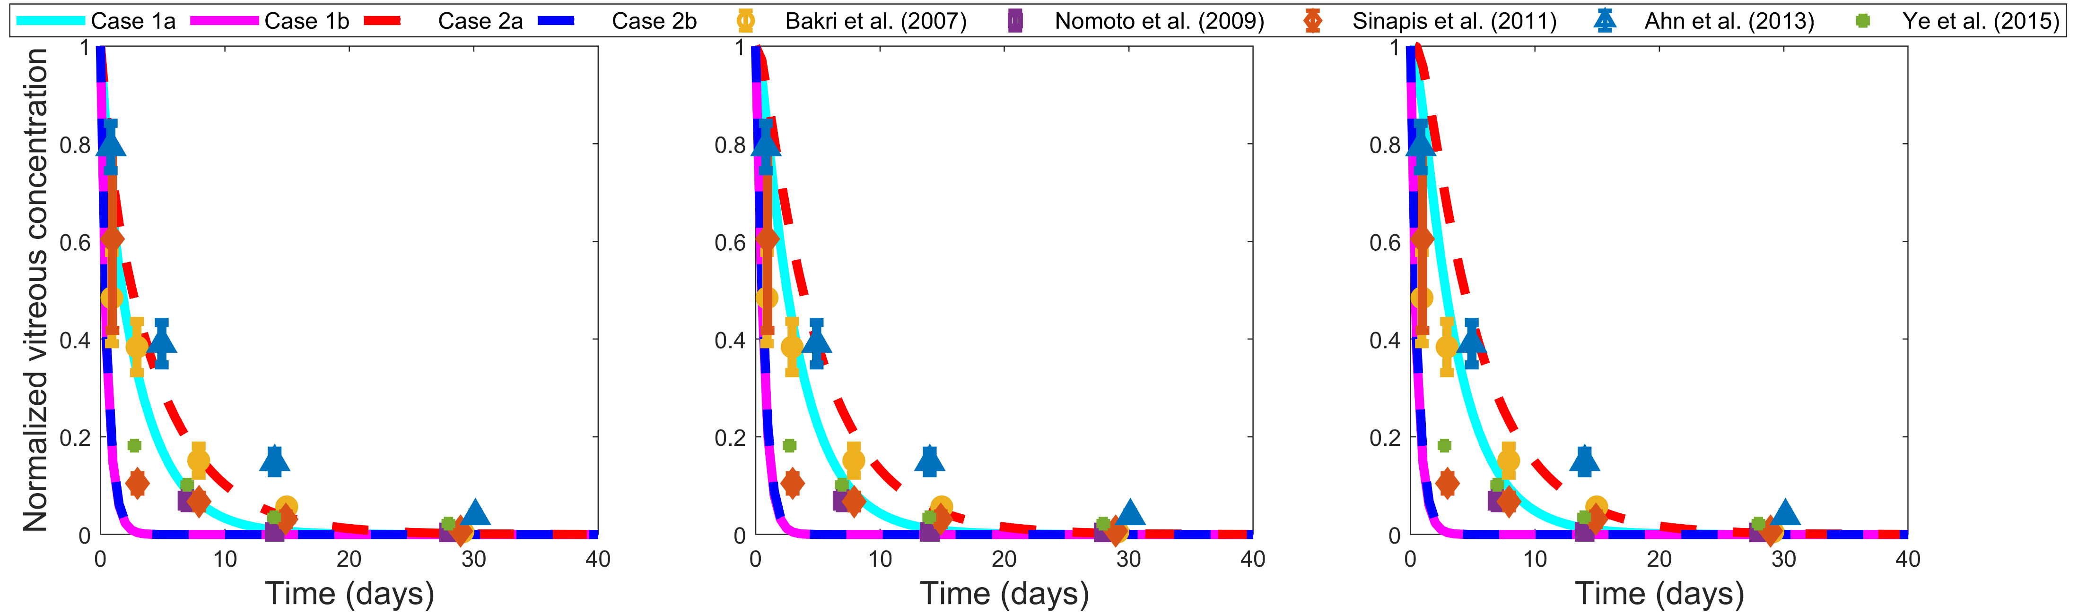
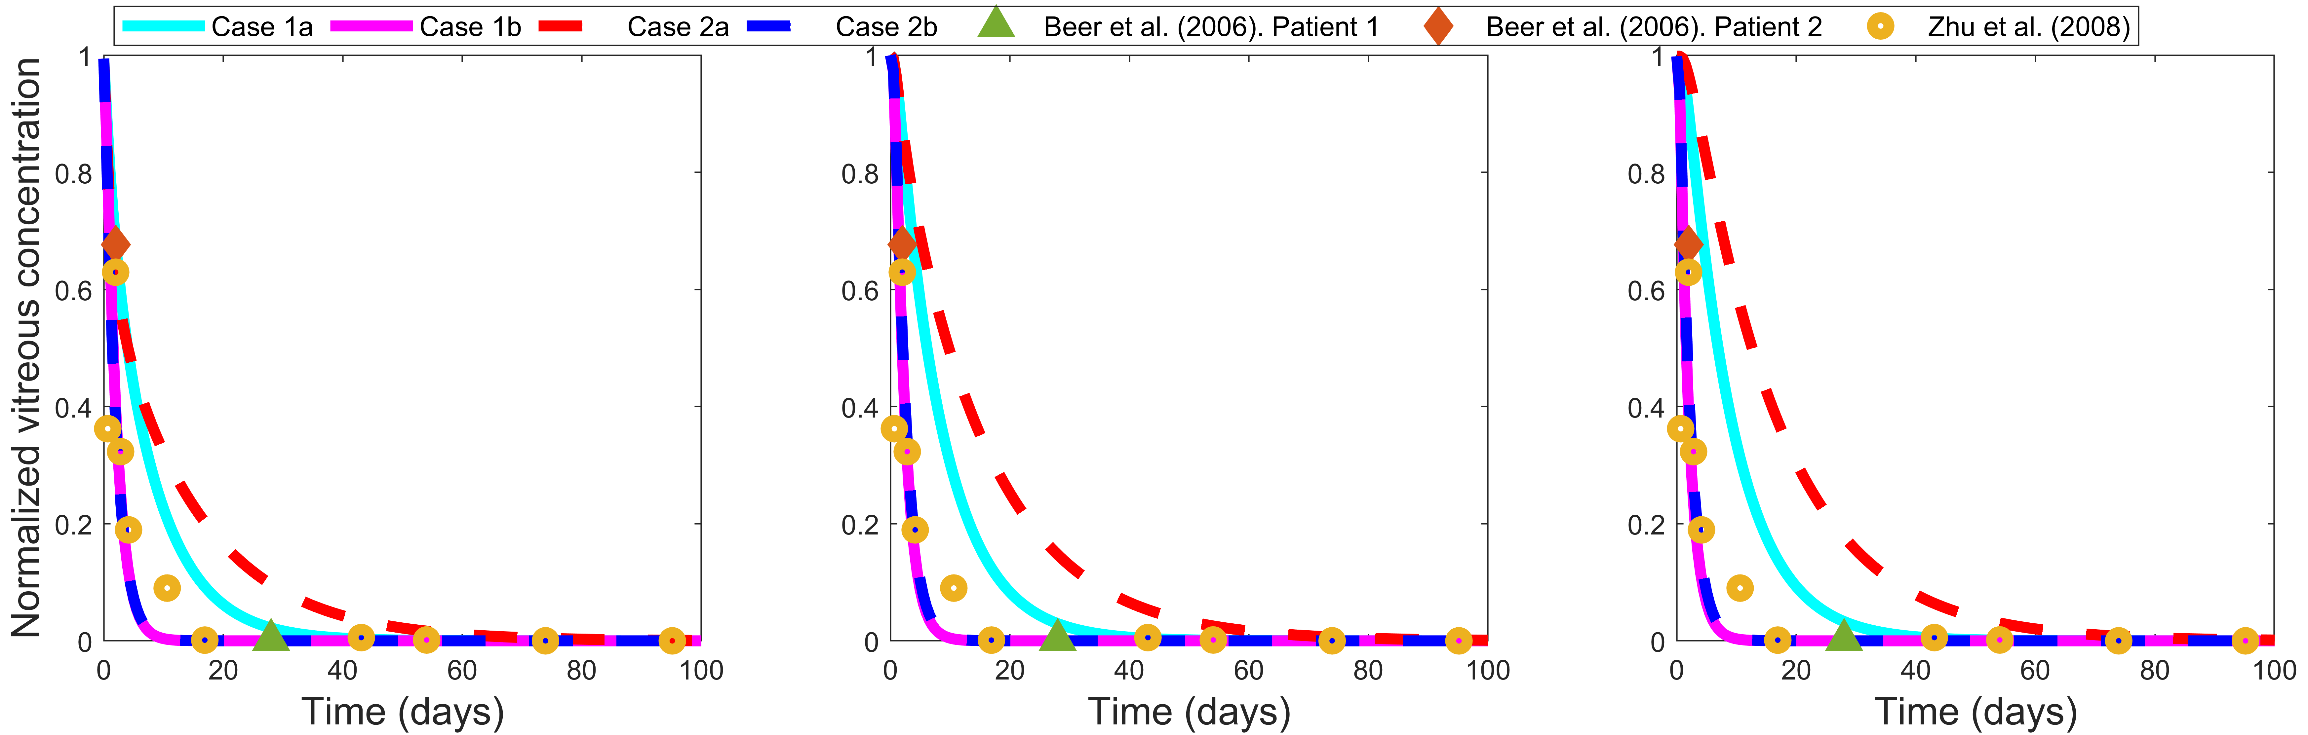
Figure 3
a)
b)
c)
d)
e)
f)

Slide 3
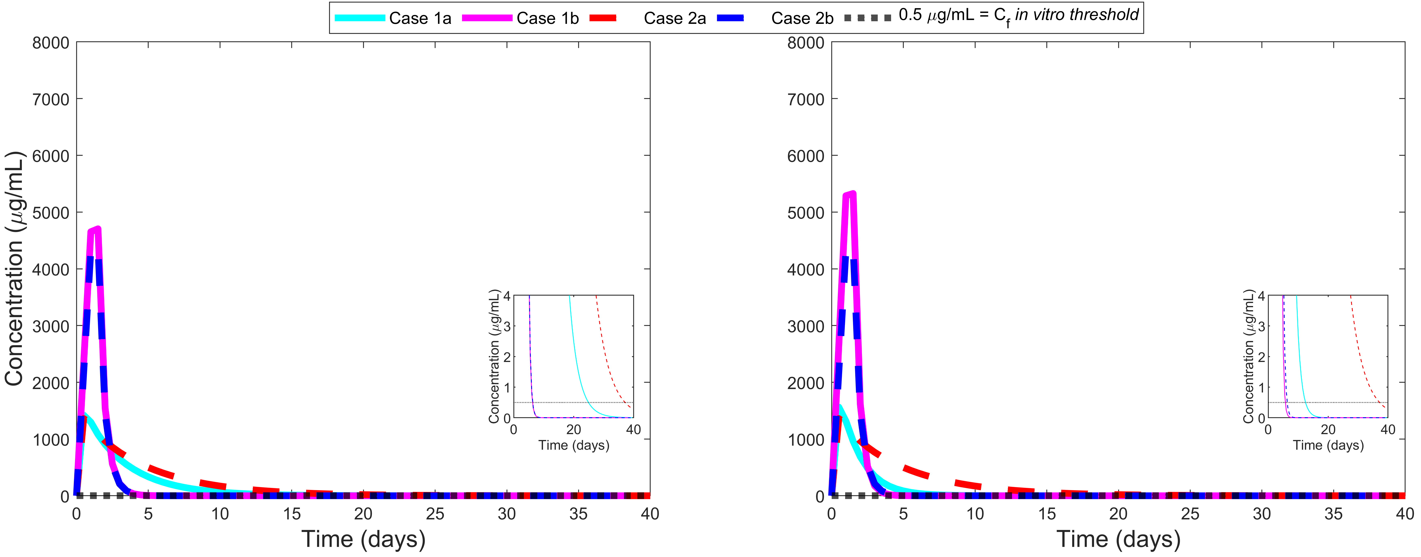
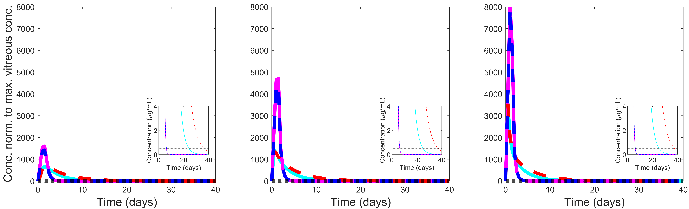
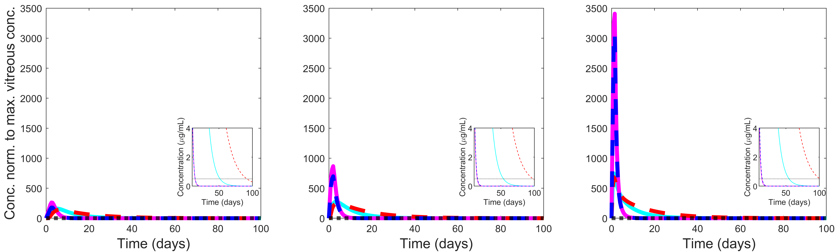
Figure 4
a)
b)
c)
d)
e)
f)

Slide 4
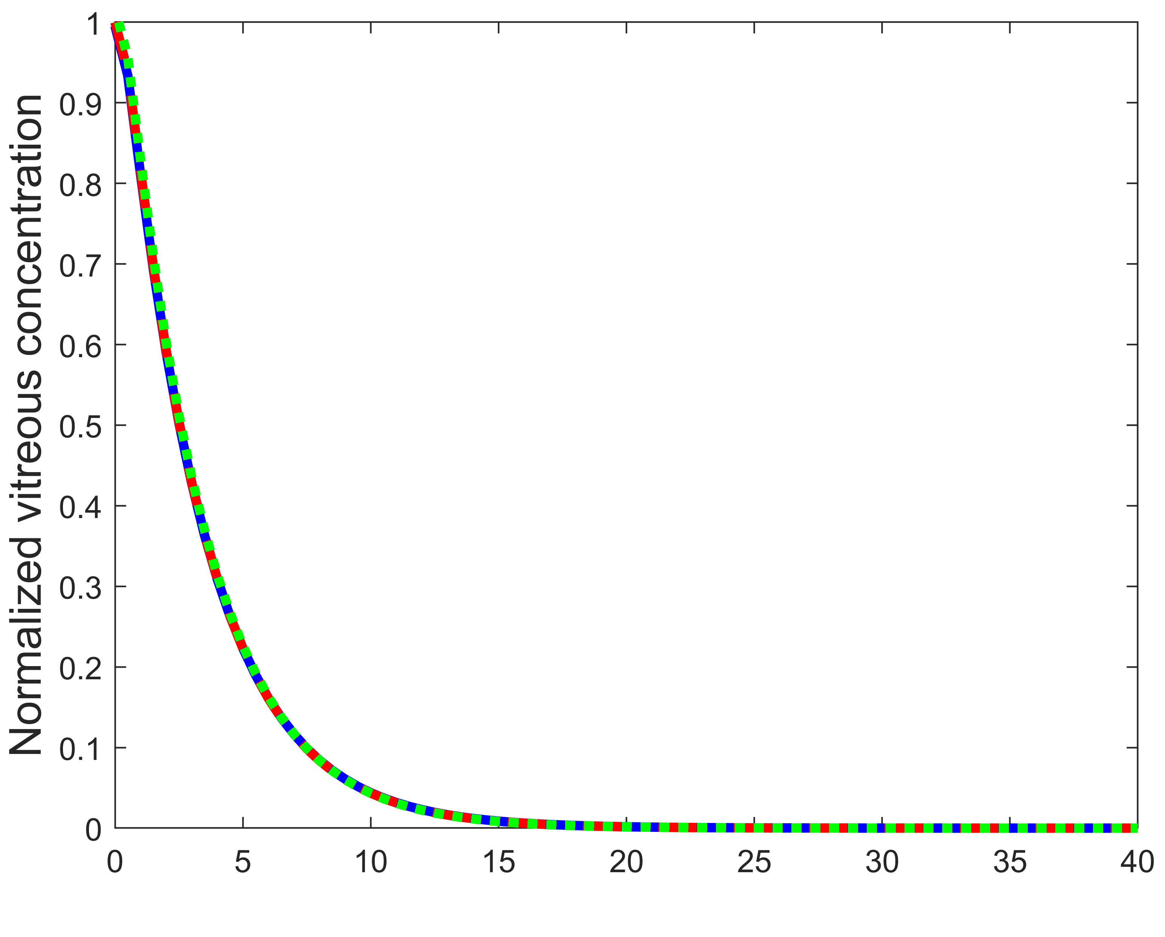
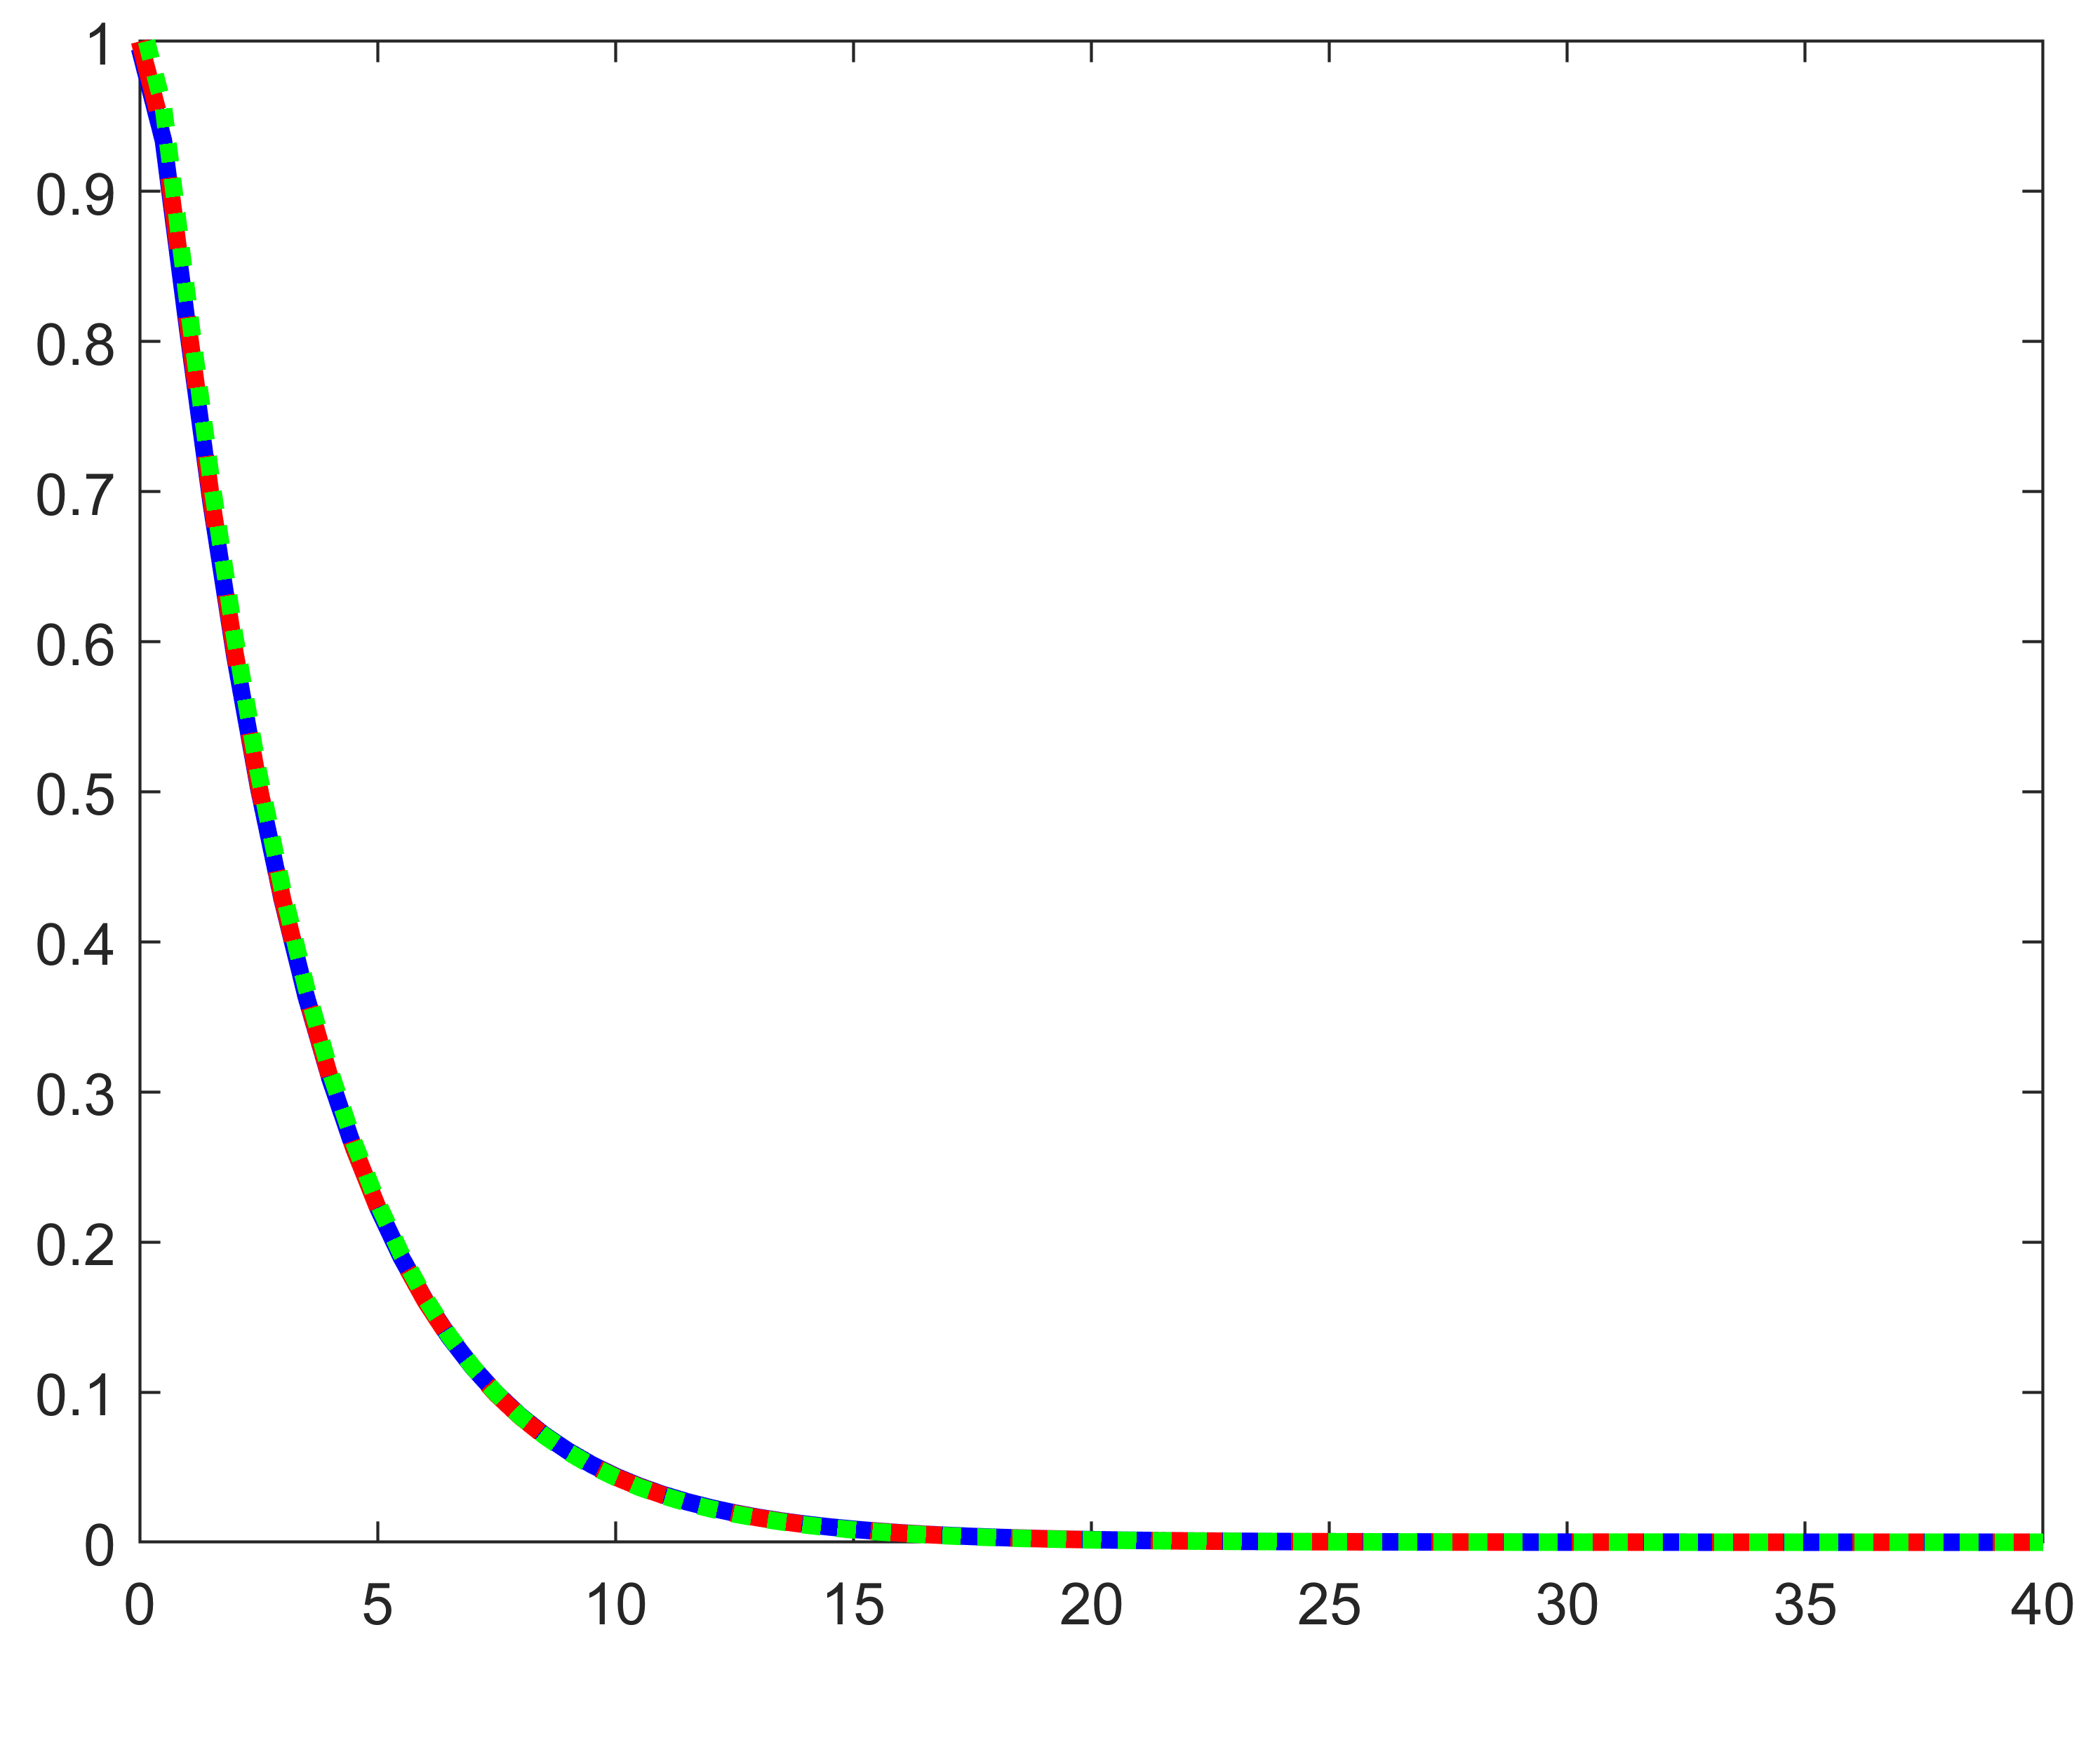
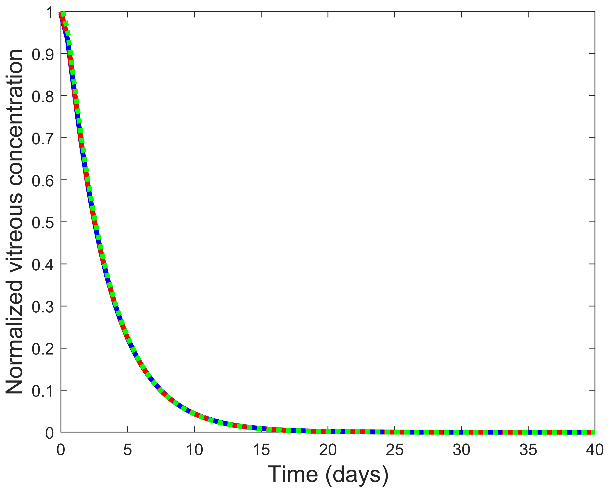
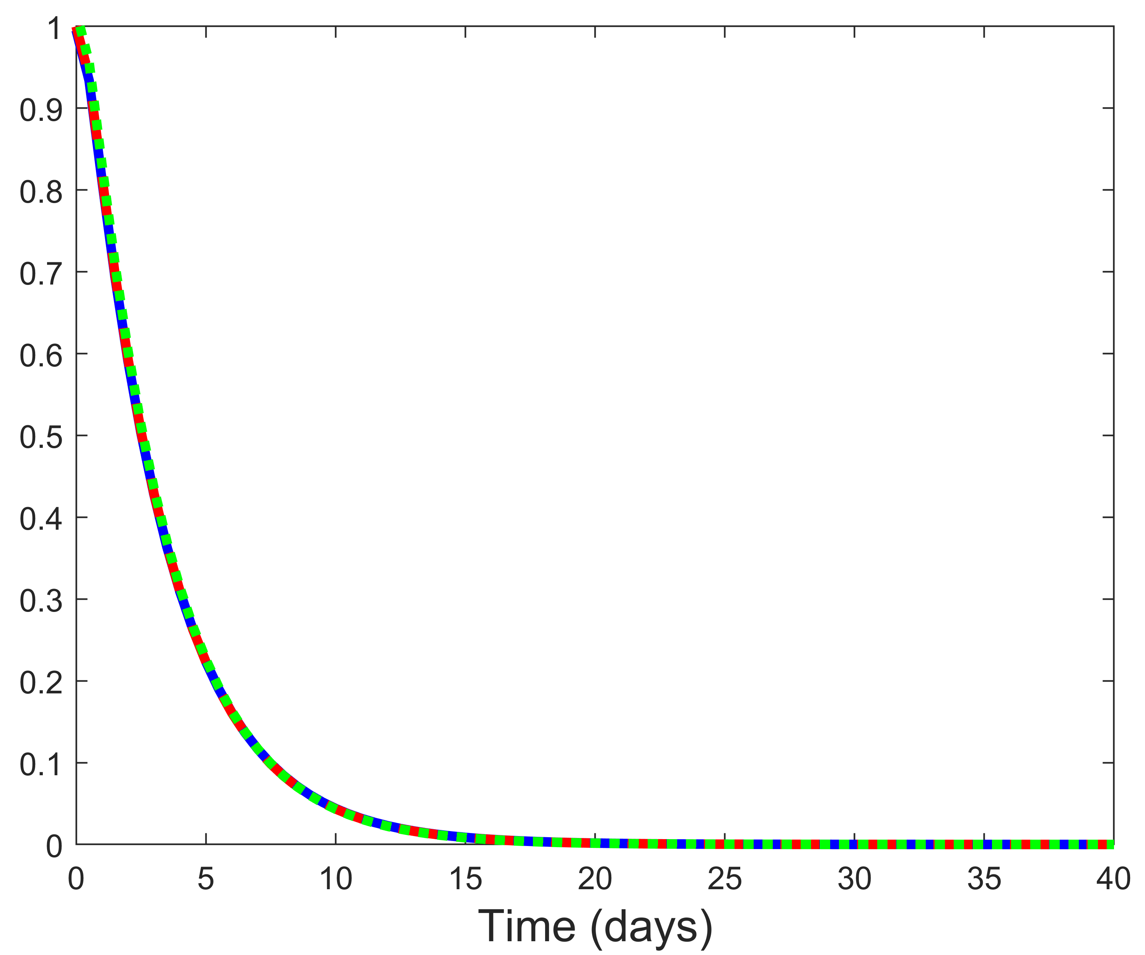
Figure S1
a)
b)
c)
d)

Slide 5
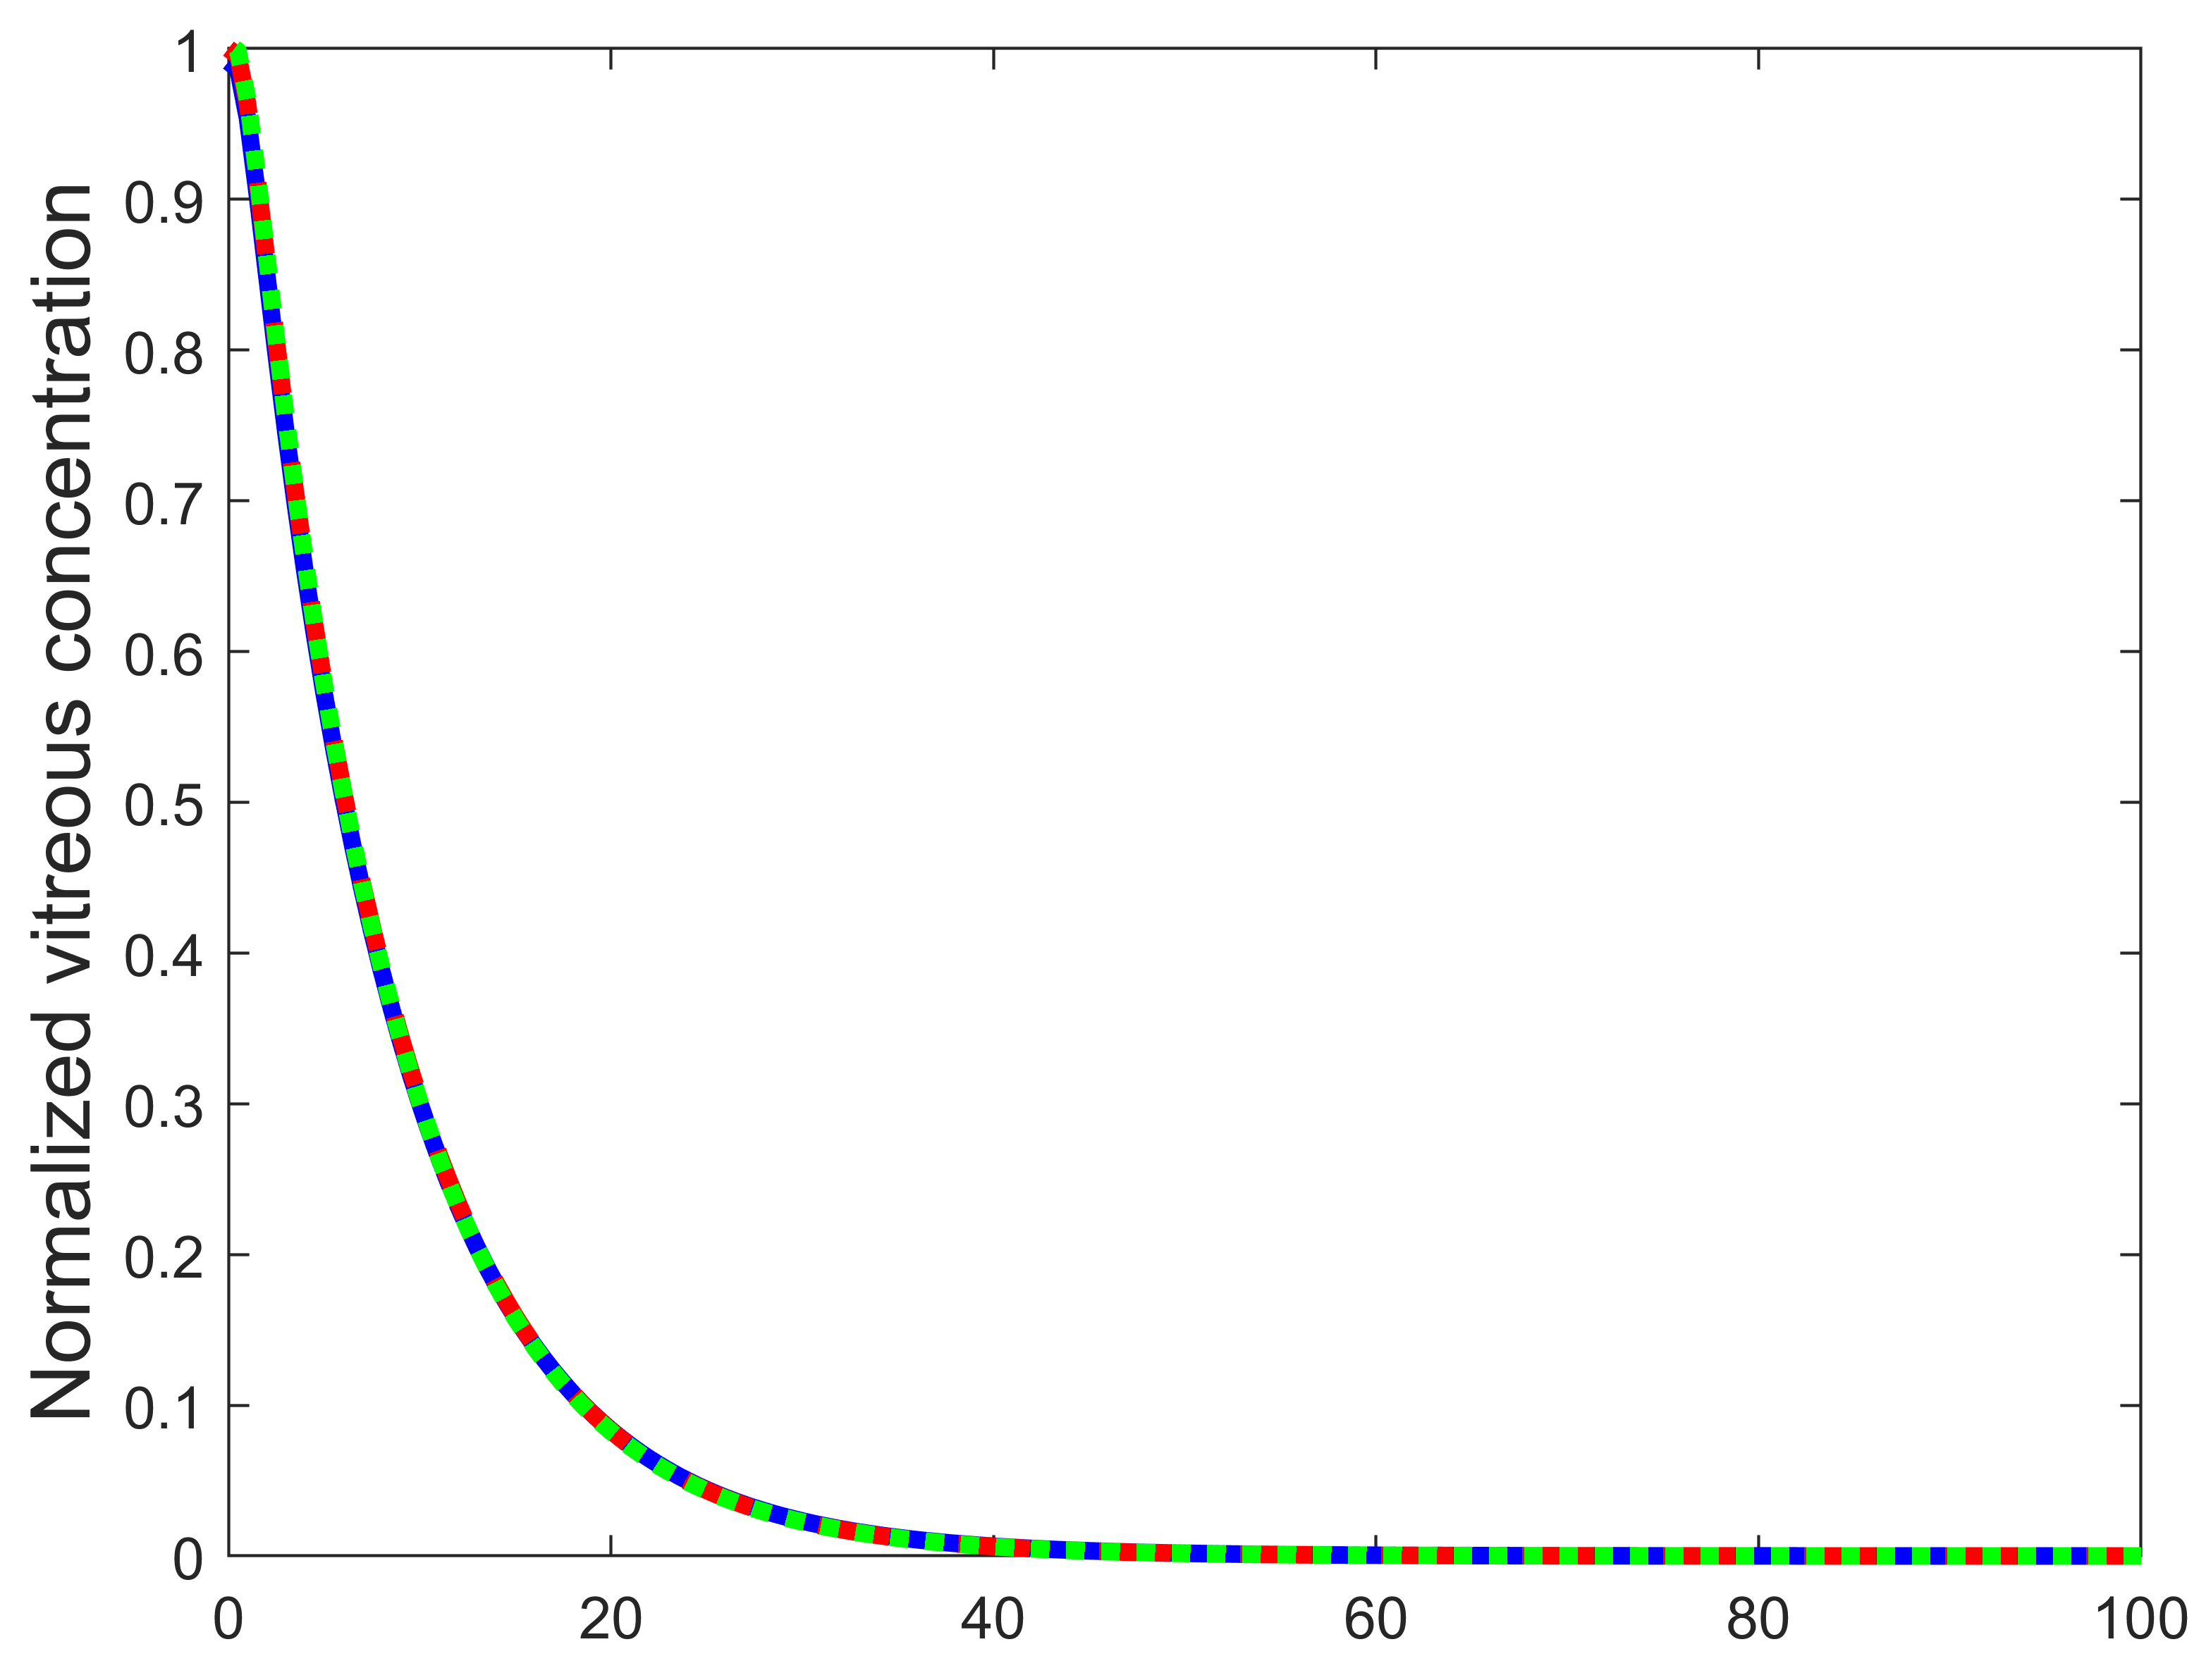
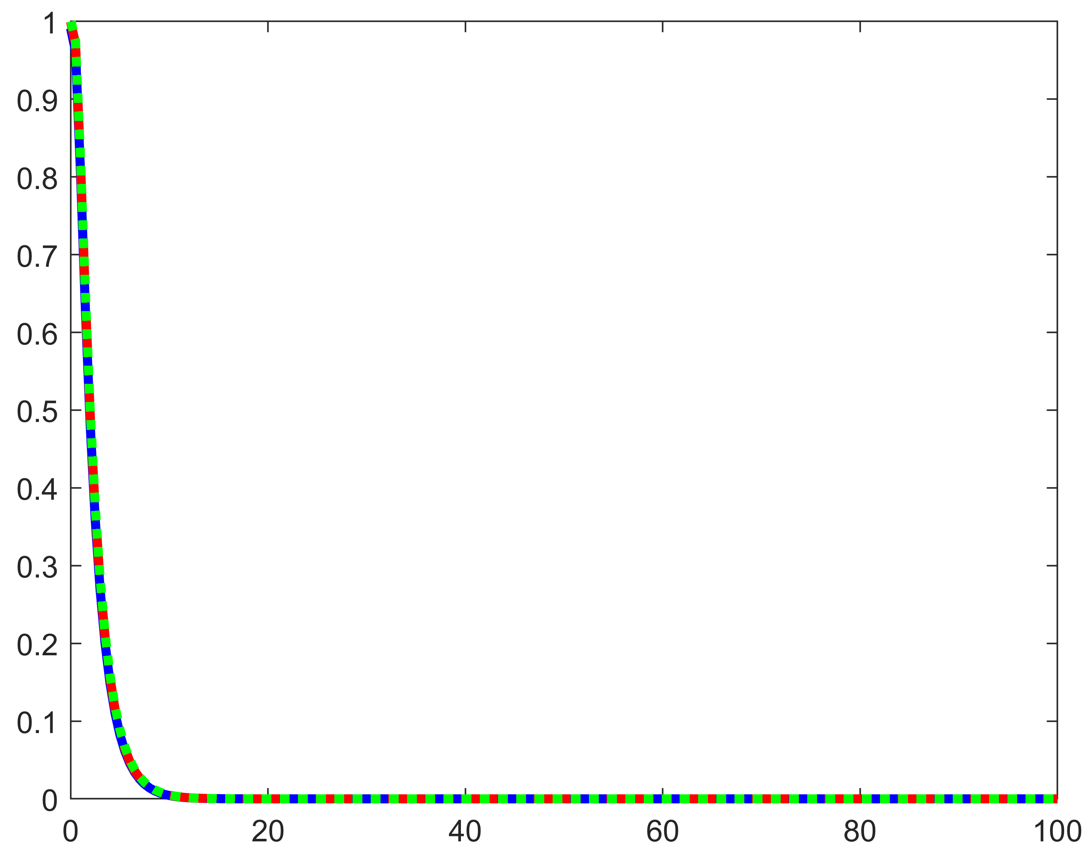
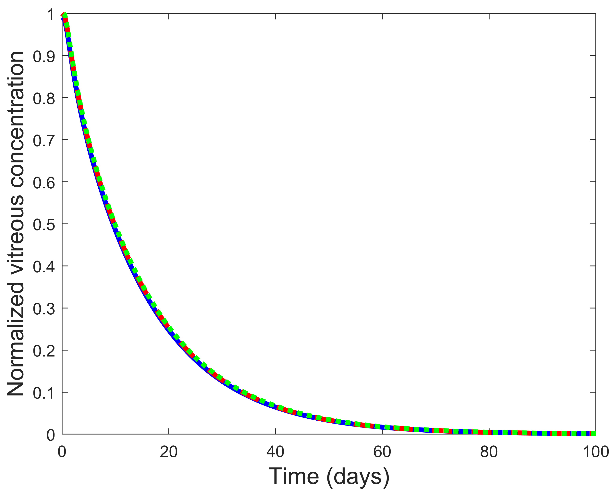
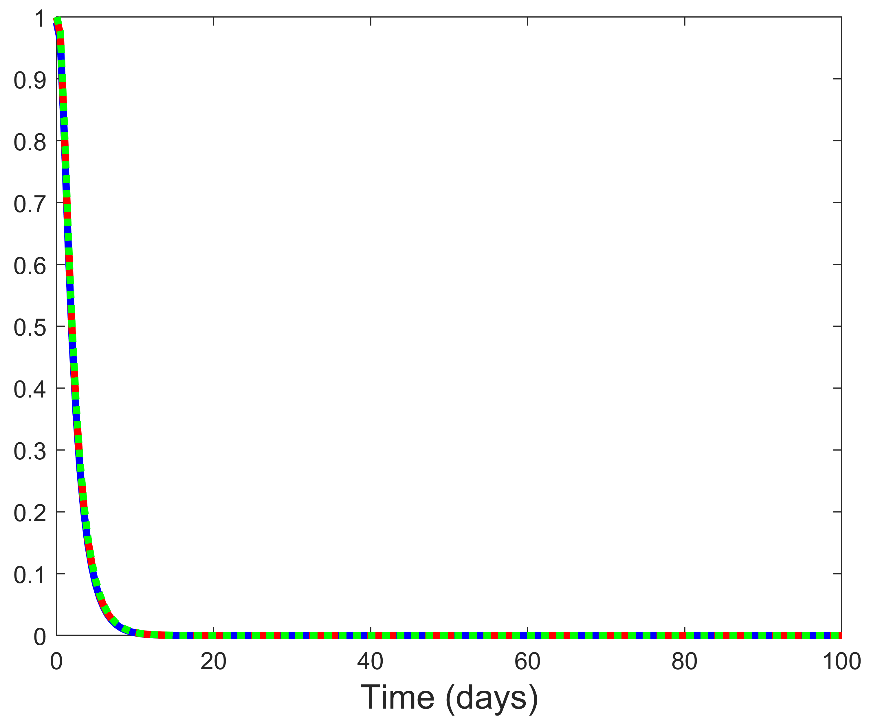
Figure S2
a)
b)
c)
d)

Slide 6
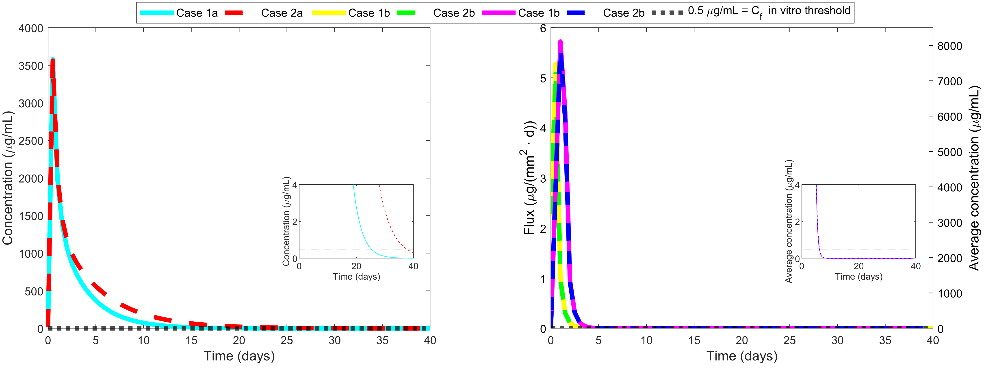
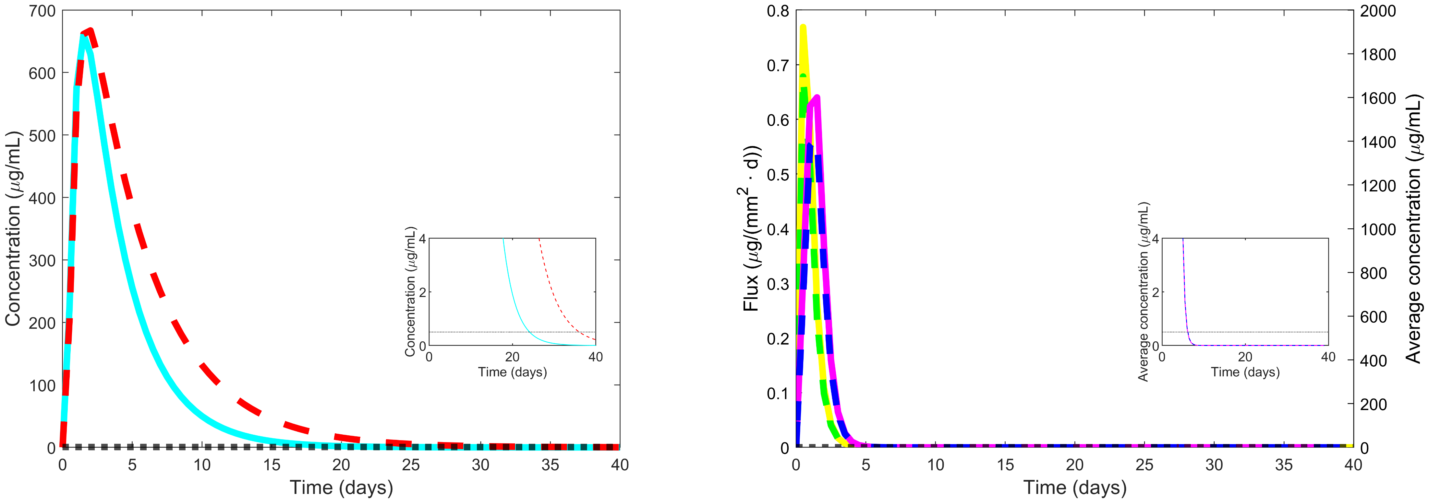
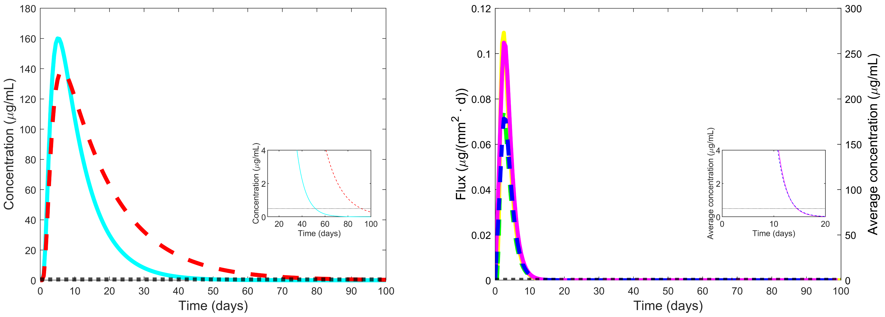
Figure S3
a)
b)
c)
d)

Slide 7
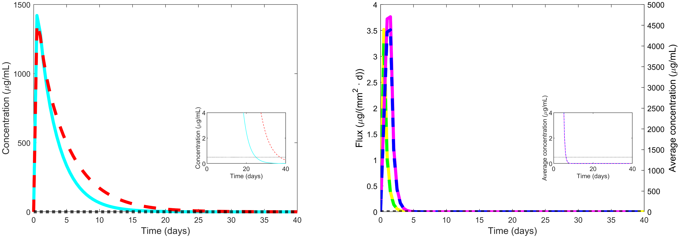
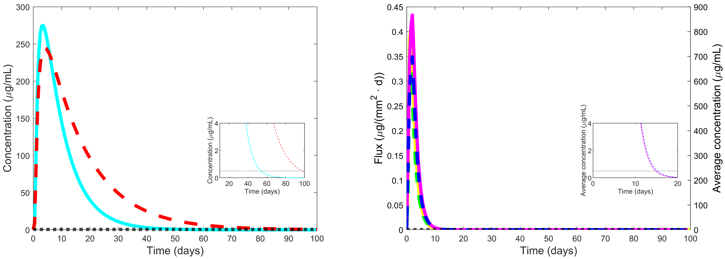
Figure S4
a)
b)
c)
d)

Slide 8
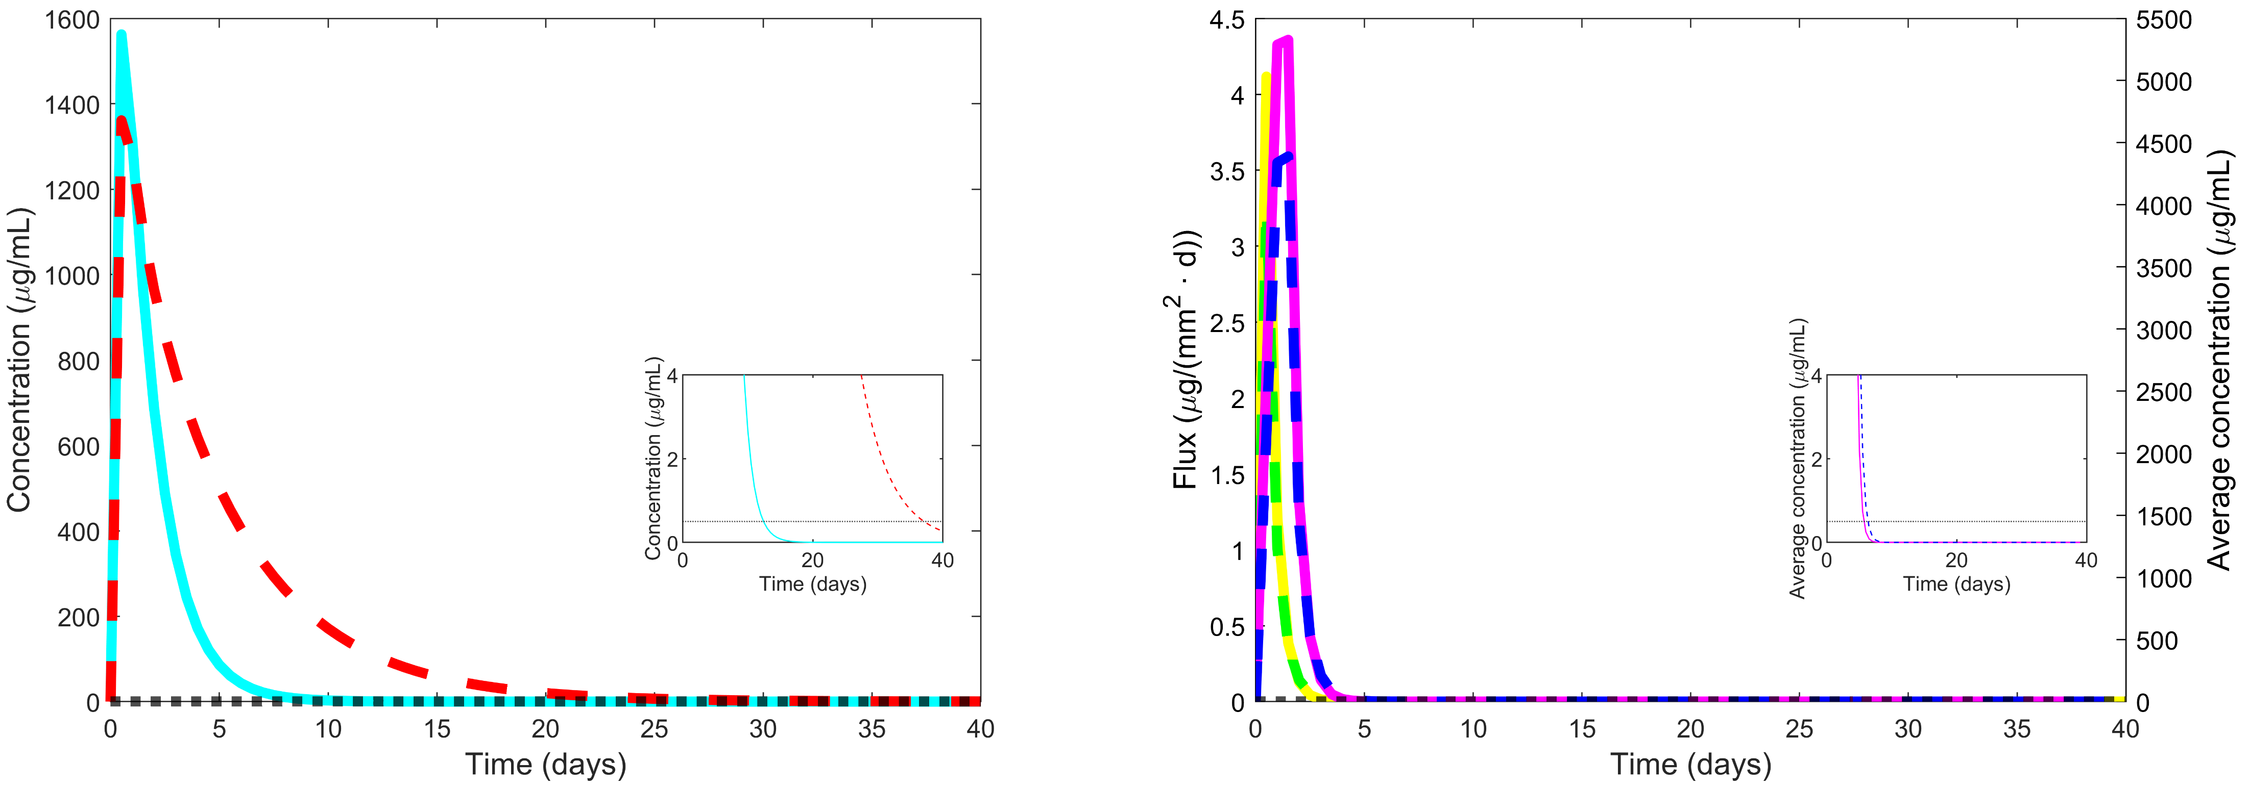
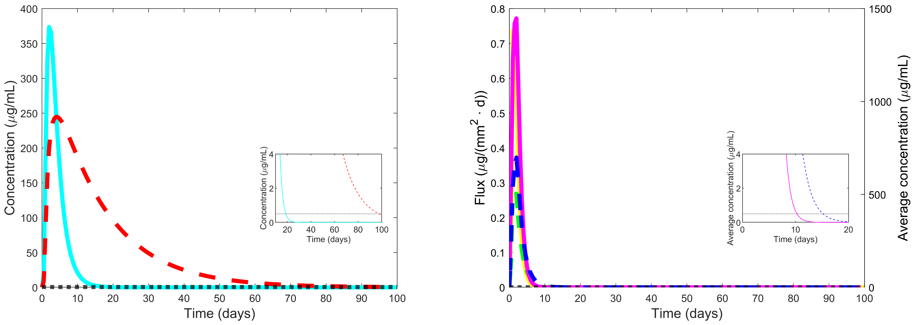
Figure S5
a)
b)
c)
d)

Slide 9
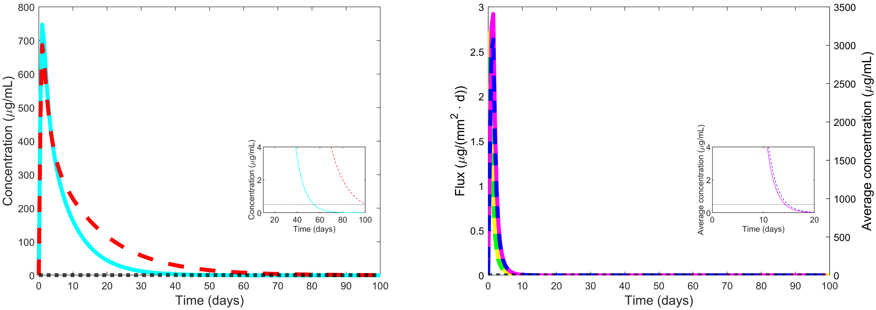
Figure S6
a)
b)
c)
d)

Slide 10
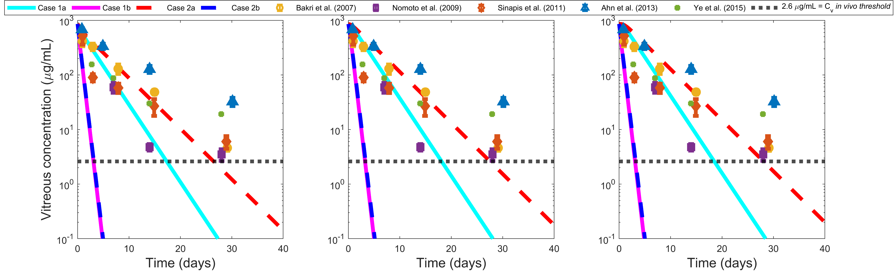

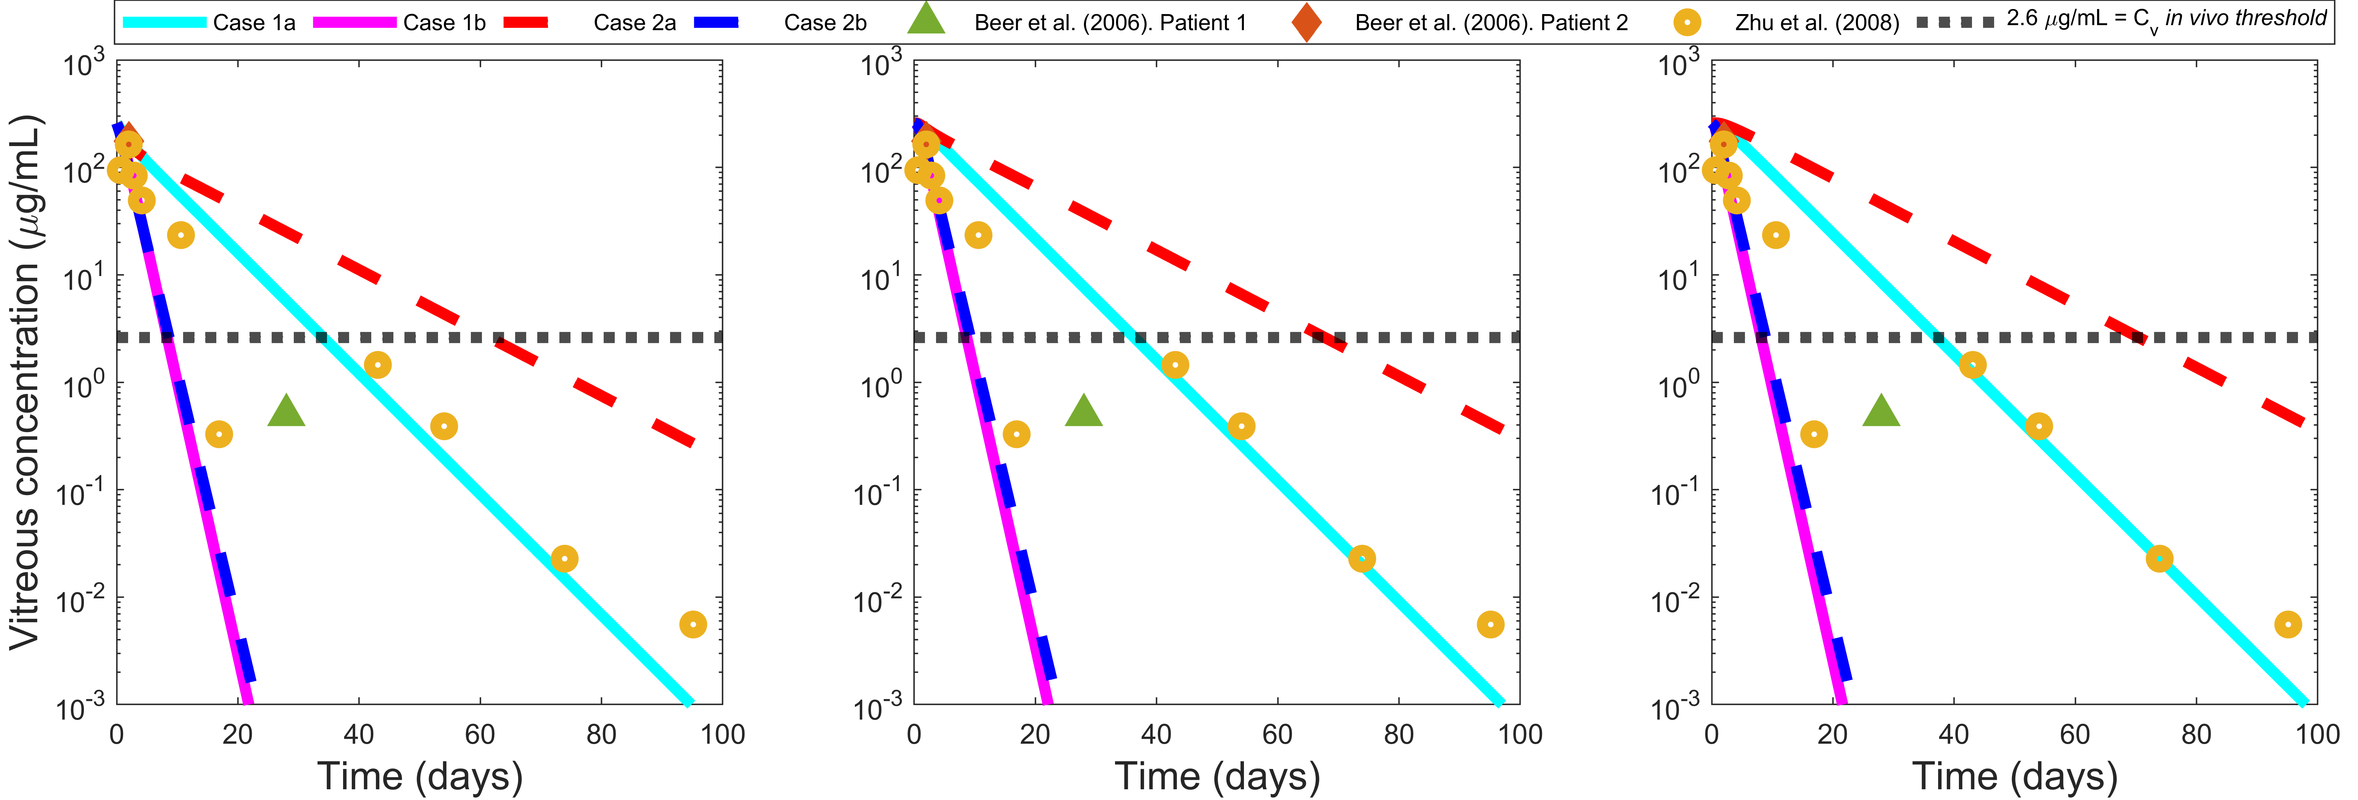
Figure S7
a)
b)
c)
d)
e)
f)

Slide 11
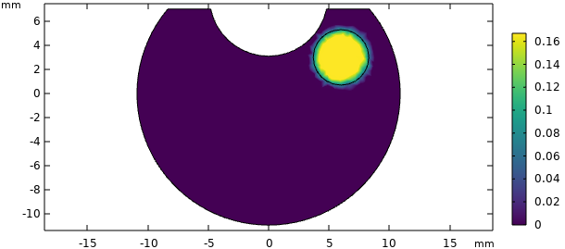
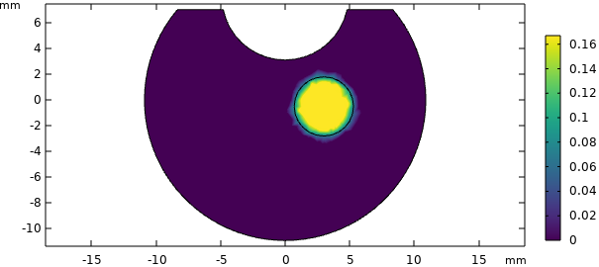
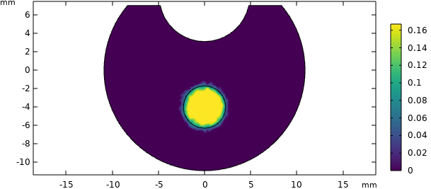
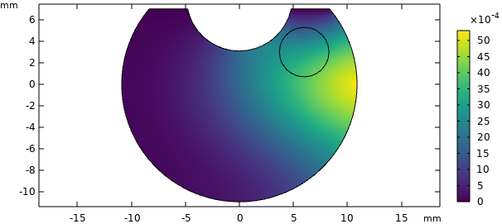
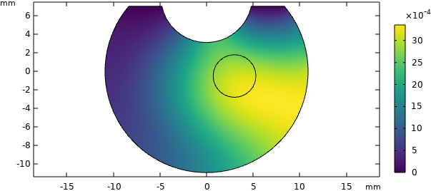
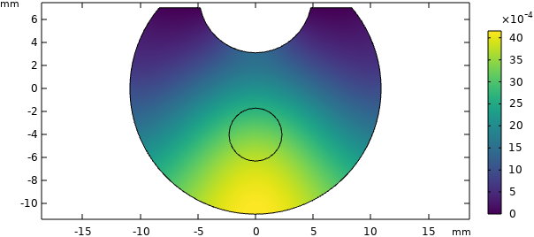
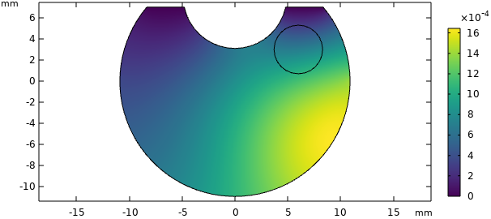
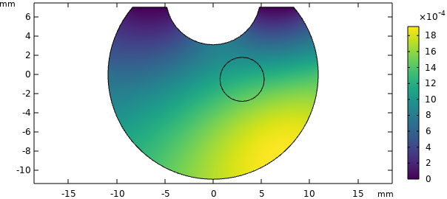
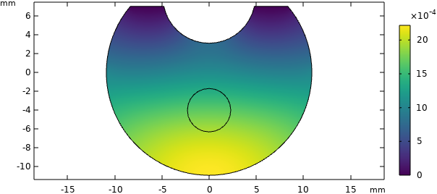
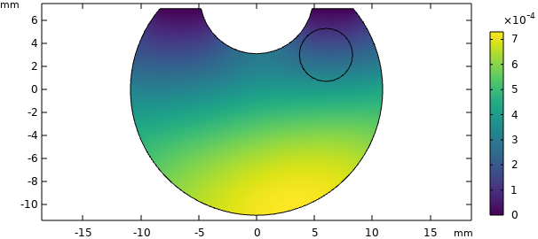
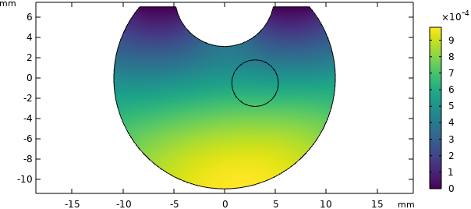
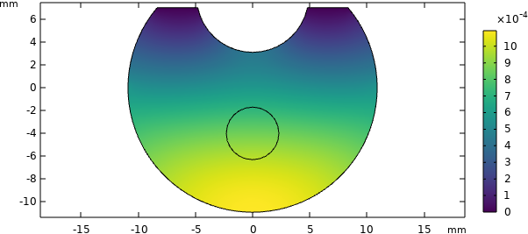
Case 1a
Figure S8
Anterior vitreous
Middle vitreous
Posterior vitreous
t = 0 days
t = 2 days
t = 5 days
t = 10 days

Slide 12
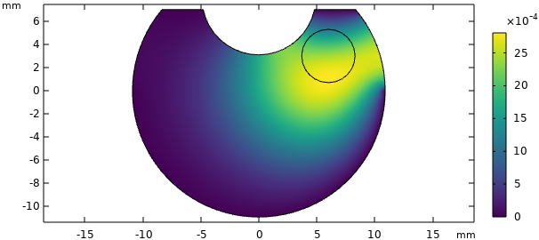
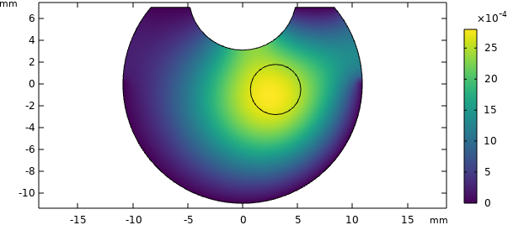
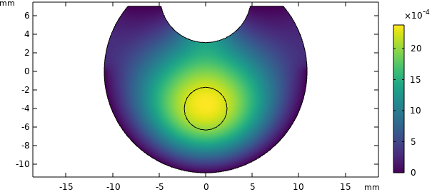
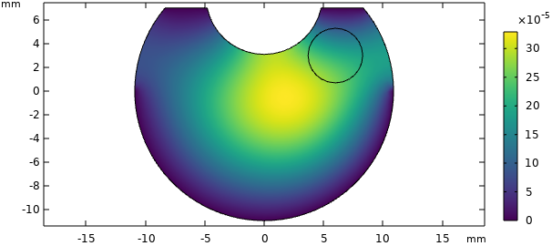
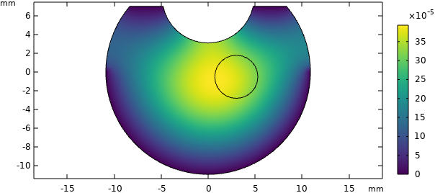
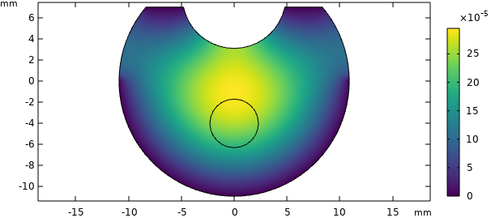
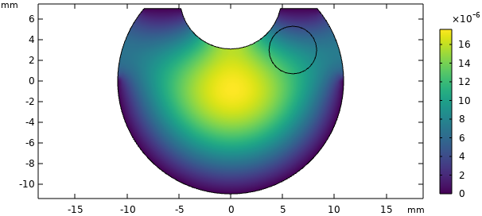

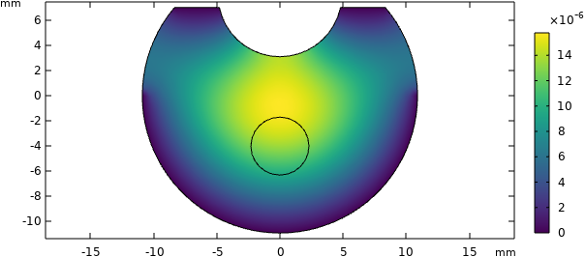
Case 1b
Figure S9
Anterior vitreous
Middle vitreous
Posterior vitreous
t = 0 days
t = 2 days
t = 5 days
t = 10 days

Slide 13
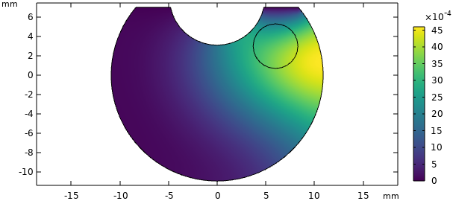
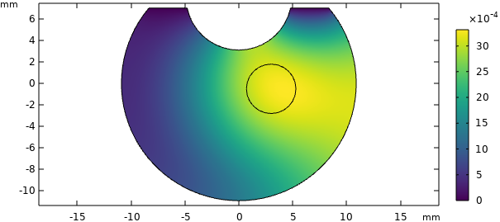
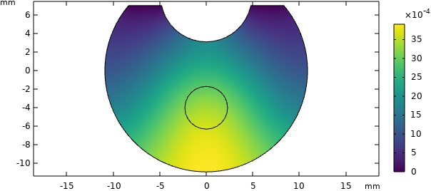
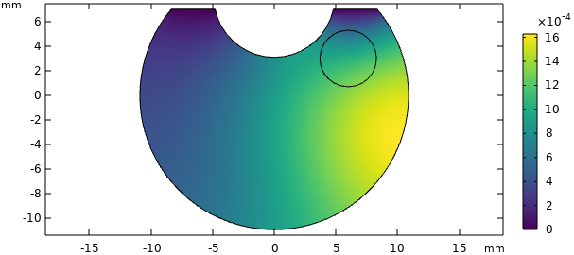
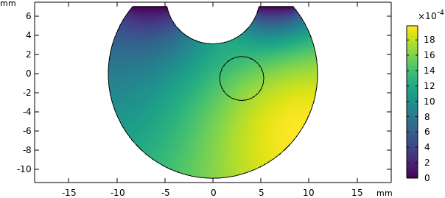
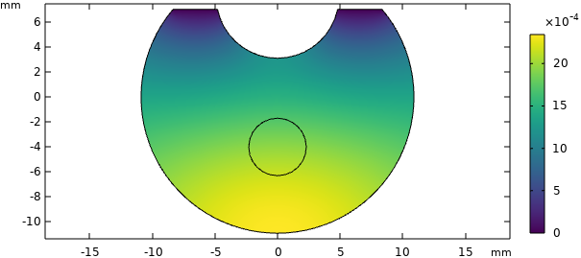



Case 2a
Figure S10
Anterior vitreous
Middle vitreous
Posterior vitreous
t = 0 days
t = 2 days
t = 5 days
t = 10 days

Slide 14









Case 2b
Figure S11
Anterior vitreous
Middle vitreous
Posterior vitreous
t = 0 days
t = 2 days
t = 5 days
t = 10 days

Slide 15


Figure S12
a)
b)

Slide 16

Figure S13

Slide 17

Figure S14
a)
b)

Slide 18



Figure S7
a)
b)
Figure S15
c)
d)

Slide 19


Figure S16
a)
b)
c)
d)

Slide 20

Figure S17
a)
b)
c)
d)

